Slide 1

Programming Languages
Third Edition
Chapter 9
Control I – Expressions and Statements

Slide 2
Objectives
Understand expressions
Understand conditional statements and guards
Understand loops and variation on WHILE
Be familiar with the GOTO controversy and loop exits
Understand exception handling
Compute the values of static expressions in TinyAda
Programming Languages, Third Edition

Slide 3
Introduction
This chapter discusses basic and structured abstraction of control through the use of expressions and statements
Expression: returns a value and produces no side effect
Statement: executed for its side effects and returns no value
In functional languages (also called expression languages), virtually all language constructs are expressions
Programming Languages, Third Edition

Slide 4
Introduction (cont’d.)
C could be called an expression-oriented language
  Expressions make up a much larger portion of the language than statements
If no side effects, expressions are closest in appearance to mathematics
  Have semantics similar to those of mathematical expressions
Semantics of expressions with side effects have a significant control component
Programming Languages, Third Edition

Slide 5
Introduction (cont’d.)
Explicit control structures first appeared as GOTOs
Algol60 brought structured control
  Control statements transfer control to and from statements that are single-entry, single exit, such as blocks
Some languages do away with GOTOs altogether, but there is still debate on the utility of GOTOs within the context of structured programming
Programming Languages, Third Edition

Slide 6
Expressions
Basic expressions consist of literals and identifiers
Complex expressions are built up recursively from basic expressions by the application of operators and functions
  May involve grouping symbols such as parentheses
Example: in the expression 3 + 4 * 5
  + operator is applied to its two operands, 3 and the subexpression 4 * 5
Unary operator: takes one operand
Binary operator: takes two operands
Programming Languages, Third Edition

Slide 7
Expressions (cont’d.)
Operators can be written in infix, postfix, or prefix notation
  Postfix and prefix forms do not require parentheses to express the order in which operators are applied
Operators are predefined, written in infix form (if binary), with special associativity and precedence rules
Functions are user-defined, with the operands viewed as arguments or actual parameters
This distinction is arbitrary, since operators and functions are equivalent concepts
Programming Languages, Third Edition

Slide 8
Expressions (cont’d.)
Distinction is significant, since built-in operators were implemented as highly optimized inline code
  Functions required the building of activations
Modern translators often inline even user-defined functions
Lisp requires expressions to be fully parenthesized because it can take variable numbers of arguments as operands
Applicative order evaluation (or strict evaluation) rule: all operands are evaluated first, then operators are applied to them
Programming Languages, Third Edition

Slide 9
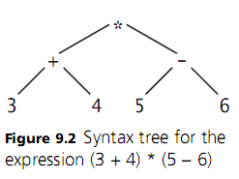
Expressions (cont’d.)
Example: applicative order evaluation
  The + and – nodes are evaluated to 7 and -1
  Then the * is applied to get -7
Programming Languages, Third Edition

Slide 10
Expressions (cont’d.)
Natural order to process (3+4) and (5-6) is left to right, but many languages do not specify an order
  Machines may have different requirements for the structure of calls to procedures and functions
  Translators may attempt to rearrange for efficiency
If there are no side effects, order of evaluation of subexpressions will make no difference
  If there are side effects, there may be differences
Programming Languages, Third Edition

Slide 11
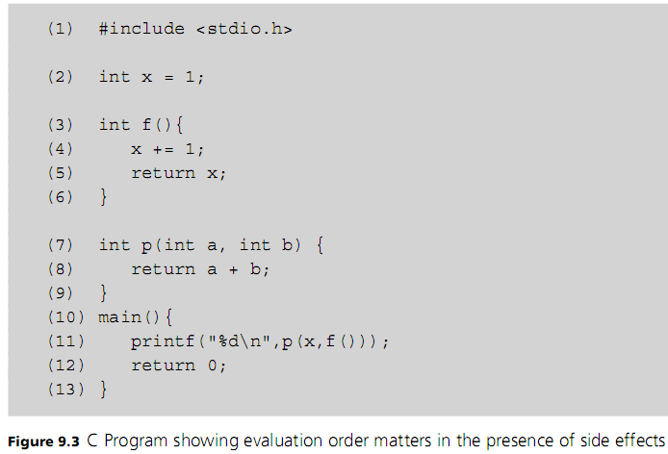
Expressions (cont’d.)
Programming Languages, Third Edition

Slide 12
Expressions (cont’d.)
Sometimes expressions are explicitly constructed with side effects in mind
In C, assignment is an expression
  Example: In C code:
    y=z both assigns and returns a value, which is assigned to x
Sequence operator: allows several expressions to be combined into a single expression and evaluated sequentially
  Example: In C code:
Programming Languages, Third Edition

Slide 13
Expressions (cont’d.)
Short-circuit evaluation: Boolean expressions are evaluated left to right up to the point where the truth value of the entire expression becomes known, and then evaluation stops
  Example: in Ada:
    Is always true, regardless of the value of x
Order of evaluation is important in short-circuit evaluation
If expressions and case expressions also may not be completely evaluated
Programming Languages, Third Edition

Slide 14
Expressions (cont’d.)
If (or if-then-else) operator: is a ternary operator with three operands
Mix-form: distributes parts of the syntax of the operator throughout the expression
  Example: in ML code:
If-expressions never have all of their subexpressions evaluated
Case expression: similar to a series of nested-if expressions
Delayed evaluation (or nonstrict evaluation): when operators delay evaluating their operands
Programming Languages, Third Edition

Slide 15
Expressions (cont’d.)
Substitution rule (or referential transparency): any two expressions that have the same value in the same scope may be substituted for each other
  Their values always remain equal regardless of the evaluation context
  Note that this prohibits variables in the expressions
Normal order evaluation: each operation begins its evaluation before its operands are evaluated, and each operand is evaluated only if it is needed for the calculation of the operation
Programming Languages, Third Edition

Slide 16
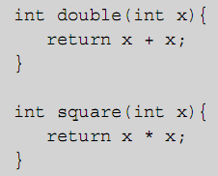
Expressions (cont’d.)
Example: in C code:
  Consider the expression
  Square is replaced by
  Without evaluating double(2)
  Then it is replaced by 2 + 2
Normal order evaluation implements a kind of code inlining
Programming Languages, Third Edition

Slide 17
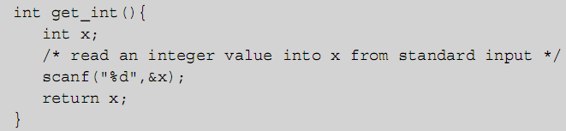
Expressions (cont’d.)
With no side effects, normal order evaluation does not change the semantics of a program
Example with side effects in C code:
  Expression would be expanded into
    Would read in two integer values instead of one
Programming Languages, Third Edition

Slide 18
Expressions (cont’d.)
Normal order evaluation:
  Appears as lazy evaluation in the functional language Haskell
  Appears as pass by name parameter passing technique for functions in Algol60
Programming Languages, Third Edition

Slide 19
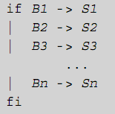
Conditional Statements and Guards
if-statement: typical form of structured control
  Execution of a group of statements occurs only under certain conditions
Guarded if statement:
  All Bi’s are Boolean expressions
  called guards
  All Si’s are statement sequences
  If one Bi evaluates to true, the
  corresponding Si is executed
  If more than one Bi is true, only
  one Si is executed
Programming Languages, Third Edition

Slide 20
Conditional Statements and Guards (cont’d.)
It does not say that the first true Bi is chosen
  This introduces nondeterminism into programming
It leaves unspecified whether all guards are evaluated
  A useful feature for concurrent programming
Usual implementation is to sequentially evaluate all Bi’s until a true one is found, then execute the corresponding Si
If-statements and case-statements are the major ways that the guarded if are implemented
Programming Languages, Third Edition

Slide 21
If-Statements
Basic form of the if-statement in EBNF in C code:
  A statement can be either a single statement or a sequence of statements surrounded by braces
This if statement is problematic, as there are two different parse trees possible:
  Called the dangling-else problem
Programming Languages, Third Edition

Slide 22
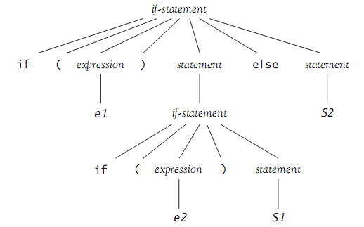
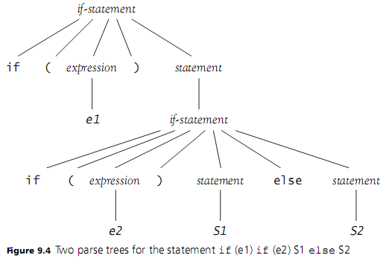
Programming Languages, Third Edition

Slide 23

If-Statements (cont’d.)
C and Pascal enforce a disambiguating rule:
  else is associated with the closest if that does not already have an else part
  Called the most closely nested rule for if-statements
A better way to solve the dangling-else problem is to use a bracketing keyword, as in the Ada rule:
  end if closes the if-statement and removes the ambiguity
Programming Languages, Third Edition

Slide 24
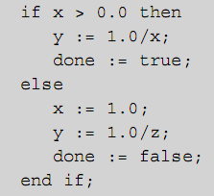
If-Statements (cont’d.)
This also removes the necessity of using brackets to open a new sequence of statements:
Programming Languages, Third Edition

Slide 25
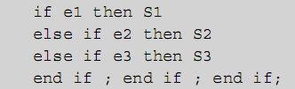
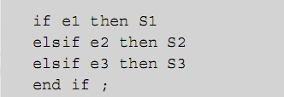
If-Statements (cont’d.)
elsif in Ada eliminates multiple end ifs when there are many alternatives:
  Becomes:
Programming Languages, Third Edition

Slide 26
Case- and Switch-Statements
Case- or switch-statement: a guarded if where the guards are ordinal values selected by an ordinal expression
Semantics in C:
  Evaluate the controlling expression
  Transfer control to the case statement where the value is listed
  No two listed cases may have the same value
  Case values may be literals or compile-time constant expressions
  If no value matches, transfer to the default case
Programming Languages, Third Edition

Slide 27
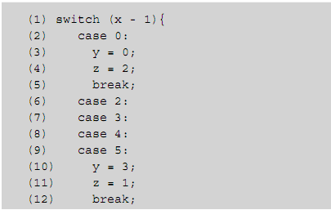
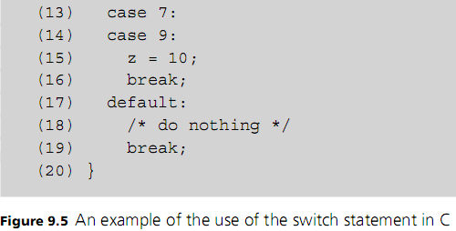
Programming Languages, Third Edition

Slide 28
Case- and Switch-Statements (cont’d.)
If there is no default case, control falls through to the next statement after the switch
Some novel features:
  Case labels are treated syntactically as ordinary labels
  Without a break statement, execution falls through to the next case
Ada allows case values to be grouped and requires that they be exhaustive
  Compile-time error if a legal value is not listed
Programming Languages, Third Edition

Slide 29
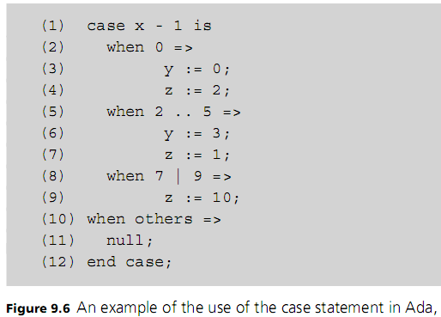
Case- and Switch-Statements (cont’d.)
Programming Languages, Third Edition

Slide 30
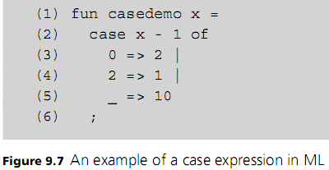
Case- and Switch-Statements (cont’d.)
ML’s case construct is an expression that returns a value, rather than a statement
  Cases are separated by vertical bars
  Case expressions are patterns to be matched
  Wildcard pattern is the underscore
Programming Languages, Third Edition

Slide 31
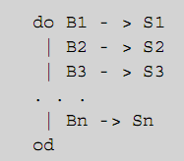
Loops and Variations on WHILE
Guarded do: a general form for a loop construct
  Statement is repeated until all Bi’s are false
  At each step, one of the true Bi’s is selected nondeterministically, and the corresponding Si is executed
Programming Languages, Third Edition

Slide 32
Loops and Variations on WHILE (cont’d.)
Basic loop construct: a guarded do with only one guard
  Eliminates nondeterminism
In C:
In Ada:
The test expression (e) is evaluated first
  Must be Boolean in Ada and Java, but not C or C++
  If true (or non-zero), then S is executed and the process repeats
Programming Languages, Third Edition

Slide 33
Loops and Variations on WHILE (cont’d.)
Some languages have an alternative form that ensures the loop is executed at least once
  In C and Java: the do (or do-while) statement
Termination of the do or while loop is explicitly specified only at the beginning or end of the loop
C and Java provide a break statement to exit completely from inside a loop
  continue statement skips the remainder of the body of the loop but resumes with the next iteration
Programming Languages, Third Edition

Slide 34
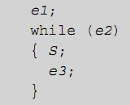

Loops and Variations on WHILE (cont’d.)
For-loop in C/C++ and Java:
  Is completely equivalent in C to:
    e1 is the initializer
    e2 is the test
    e3 is the update
For-loop is typically used to run through a set of values from first to last
Programming Languages, Third Edition

Slide 35

Loops and Variations on WHILE (cont’d.)
C++ and Java allow a for-loop initializer (index) to be declared in the loop:
Many languages restrict the format of the for-loop
Most restrictions involve the control variable i:
  Value of i cannot be changed in the body of the loop
  Value of i is undefined after loop termination
  i must be of restricted type and may not be a parameter to a procedure or record field
Programming Languages, Third Edition

Slide 36
Loops and Variations on WHILE (cont’d.)
Other questions about loop behavior include:
  Are bounds evaluated only once? If so, bounds may not change after execution begins
  Is the loop executed at all if the lower bound is greater than the upper bound?
  Is the control variable value undefined if an exit or break statement is used?
  What translator checks are performed on loop structures?
Object-oriented languages use an iterator object for looping over elements of a collection
Programming Languages, Third Edition

Slide 37
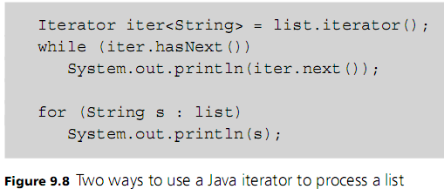
Loops and Variations on WHILE (cont’d.)
Programming Languages, Third Edition

Slide 38
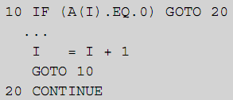
The GOTO Controversy and Loop Exits
Gotos were used heavily in early programming languages such as Fortran77 and BASIC
Example in Fortran77:
  Is equivalent to this C code:
Programming Languages, Third Edition

Slide 39
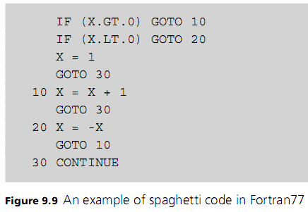
The GOTO Controversy and Loop Exits (cont’d.)
In the 1960s with structured control use increasing, debate began about the usefulness of gotos
  Can lead to spaghetti code
Programming Languages, Third Edition

Slide 40
The GOTO Controversy and Loop Exits (cont’d.)
In 1966, Bohm and Jacopini produced theoretical result that gotos were completely unnecessary
In 1968, Dijkstra published “GOTO Statement Considered Harmful”
  Proposed that its use be severely controlled or abolished
Many considered gotos to be justified in certain cases
In 1987, Rubin published ““Goto considered harmful” considered harmful”
Programming Languages, Third Edition

Slide 41
The GOTO Controversy and Loop Exits (cont’d.)
Still some debate on the propriety of unstructured exits from loops
  Some argue there should only be one exit in a loop
  Others argue that may require more complicated code for certain situations
Example: searching an array for a given element
  Method returns the index of the target element if it is in the array, or -1 otherwise
Example: sentinel-based loop for processing a series of input values
  Called the loop and a half problem
Programming Languages, Third Edition

Slide 42
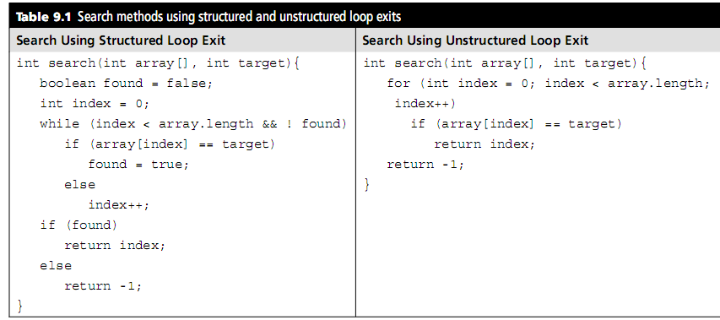
The GOTO Controversy and Loop Exits (cont’d.)
Programming Languages, Third Edition

Slide 43
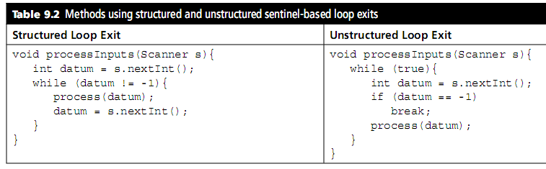
The GOTO Controversy and Loop Exits (cont’d.)
Programming Languages, Third Edition

Slide 44
Exception Handling
Explicit control mechanisms: at the point where transfer of control takes place, there is a syntactic indication of the transfer
Implicit transfer of control: the transfer is set up at a different point than where the actual transfer takes place
Exception handling: control of error conditions or other unusual events during execution
  Involves the declaration of both exceptions and exception handlers
Programming Languages, Third Edition

Slide 45
Exception Handling (cont’d.)
When an exception occurs, it is said to be raised or thrown
Examples of exceptions:
  Runtime exceptions: out-of-range array subscripts or division by zero
  Interpreted code: syntax or type errors
Exception handler: procedure or code sequence designed to be executed when a particular exception is raised
An exception handler is said to handle or catch an exception
Programming Languages, Third Edition

Slide 46
Exception Handling (cont’d.)
Virtually all major current languages have built-in exception-handling mechanisms
  Those languages without this sometimes have libraries available that provide it
Exception handling attempts to imitate the features of a hardware interrupt or error trap
  If the underlying machine or operating system is left to handle the error, the program will usually abort or crash
Programs that crash fail the test of robustness
Programming Languages, Third Edition

Slide 47
Exception Handling (cont’d.)
Cannot expect a program to be able to handle every possible error that can occur
  Too many possible failures, including hardware
Asynchronous exceptions: when the underlying operating system detects a problem and needs to terminate a program
  Not in response to program code being executed
Synchronous exceptions: exceptions that occur in direct response to actions by the program
Programming Languages, Third Edition

Slide 48
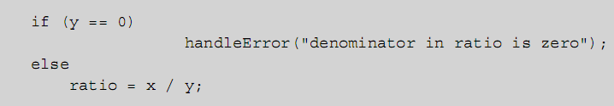
Exception Handling (cont’d.)
User-defined exceptions can only be synchronous
Predefined or library exceptions may include some asynchronous exceptions
Exception handling assumes that it is possible to test for exceptions in the language
Can handle the error at the location where it occurs:
Programming Languages, Third Edition

Slide 49
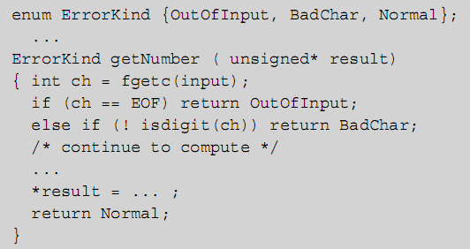
Exception Handling (cont’d.)
Can pass an error condition back to a caller of a procedure
Programming Languages, Third Edition

Slide 50
Exception Handling (cont’d.)
Can also create a separate exception-handling procedure to call
To make error handling easier, we would like to declare exceptions in advance of their occurrence and specify the actions to be taken
To do so, must consider issues related to:
  Exceptions
  Exception handlers
  Control
Programming Languages, Third Edition

Slide 51

Exceptions
Exception is typically represented by a data object, either predefined or user-defined
  In a functional language, it will be a value
  In a structured or object-oriented language, it will be a variable or an object of some structured type
Example: in ML or Ada:
Example: in C++:
Programming Languages, Third Edition

Slide 52
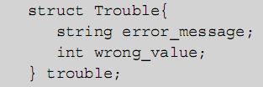
Exceptions (cont’d.)
Typically want to include additional information with an exception, such as error message or summary of data involved
Exception declarations typically observe the same scope rules as other declarations
  May be desirable to declare user-defined exceptions globally to ensure they are reachable
Programming Languages, Third Edition

Slide 53
Exceptions (cont’d.)
Most languages provide some predefined exception values or types, either directly or in standard library modules
Programming Languages, Third Edition

Slide 54
Exception Handlers
In C++, exception handlers are associated with try-catch blocks
  Any number of catch blocks can be included
  Each catch block takes the exception type as a parameter and includes a compound statement of actions to be taken
  Last catch block with parameter of … is to catch any exceptions not handled in the prior catch blocks
Programming Languages, Third Edition

Slide 55
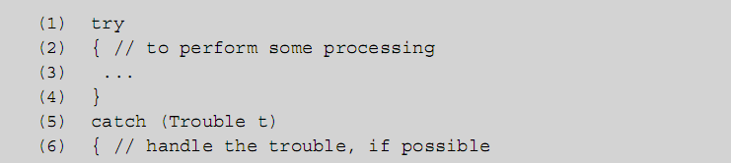
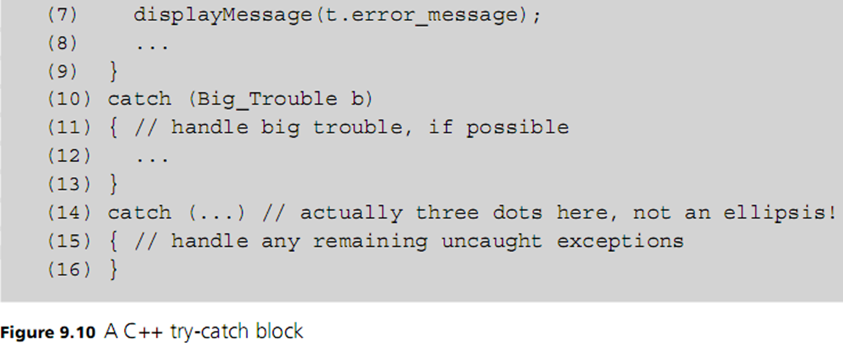
Exception Handlers (cont’d.)
Programming Languages, Third Edition

Slide 56
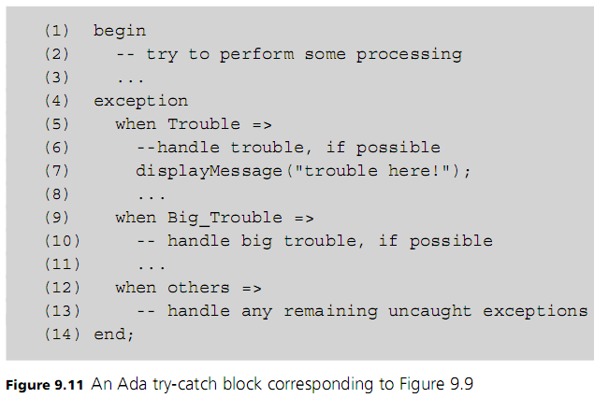
Exception Handlers (cont’d.)
Programming Languages, Third Edition

Slide 57
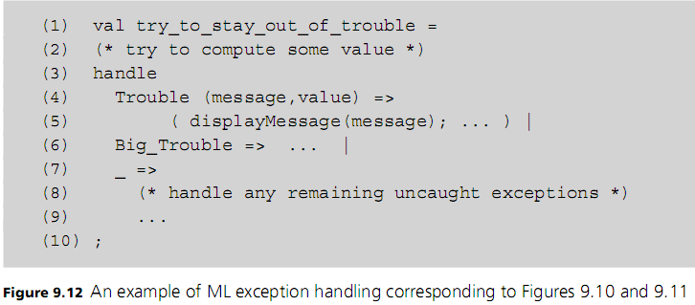
Exception Handlers (cont’d.)
Programming Languages, Third Edition

Slide 58
Exception Handlers (cont’d.)
Predefined handlers typically print a minimal error message, indicating type of exception and possibly some additional information, then terminate the program
In Ada and ML, there is no way to change the behavior of default handlers
  Can disable it in Ada
In C++, can replace the default handler with a user-defined handler using the <exceptions> standard library module
Programming Languages, Third Edition

Slide 59
Control
Predefined or built-in exceptions are either automatically raised by the runtime system or can be manually raised by the program
User-defined exceptions can only be raised by the program
In C++, an exception can be raised with the throw reserved word
Ada and ML both use the reserved word raise
Programming Languages, Third Edition

Slide 60
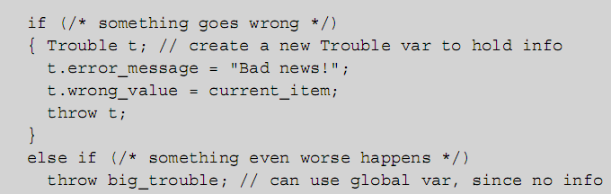
Control (cont’d.)
Example: In C++ code
Programming Languages, Third Edition

Slide 61
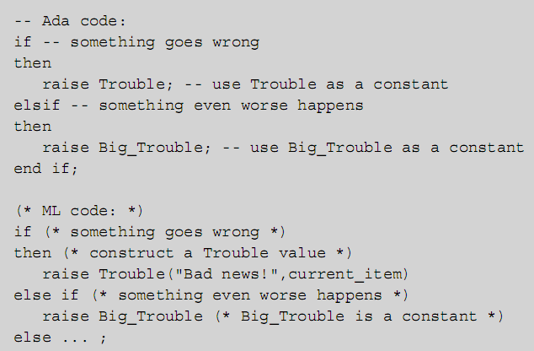
Control (cont’d.)
Programming Languages, Third Edition

Slide 62
Control (cont’d.)
When an exception is raised, the current computation is abandoned, and the runtime system begins to search for a handler
In Ada and C++, the current block is searched first, then the enclosing block, and so on
  This is called propagating the exception
If the outermost block of a function or procedure is reached without finding a handler, the call is exited and the exception is raised in the caller
Process continues until a handler is found or the main program is exited, calling the default handler
Programming Languages, Third Edition

Slide 63
Control (cont’d.)
Call unwinding (or stack unwinding): process of exiting back through function calls to the caller during the search for a handler
Once a handler is found and executed, where should execution continue?
  Resumption model: continue at the point at which the exception was first raised, and redo that same statement or expression
  Termination model: continue with the code immediately following the block or expression in which the handler that was executed is found
Programming Languages, Third Edition

Slide 64
Control (cont’d.)
Most modern languages use the termination model
  Generally easier to implement and fits better into structured programming techniques
  Can simulate the resumption model when needed
Avoid overusing exceptions to implement ordinary control situations because:
  Exception handling often carries substantial runtime overhead
  Exceptions represent a not very structured control alternative
Use simple tests instead
Programming Languages, Third Edition

Slide 65
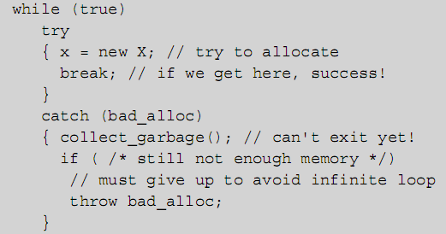
Control (cont’d.)
Example: In C++, simulating the resumption model when a call to new failed due to insufficient memory
Programming Languages, Third Edition

Slide 66
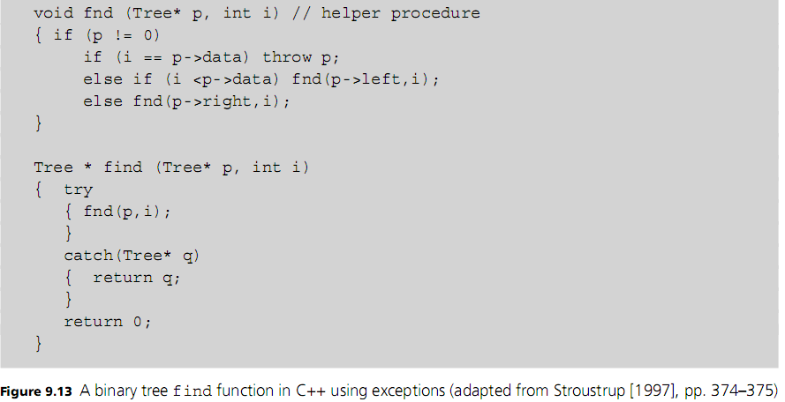
Control (cont’d.)
Programming Languages, Third Edition

Slide 67
Case Study: Computing the Values of Static Expressions in TinyAda
Pascal requires its symbolic constants to be defined as literals
Ada allows static expressions as constants
Static expression: any expression not including a variable or a function call, whose value can be determined at compile time
Programming Languages, Third Edition

Slide 68

The Syntax and Semantics of Static Expressions
Static expressions can appear in two types of TinyAda declarations:
  A number declaration, which defines a symbolic constant
  A range type definition, which defines a new subrange type
Example:
Programming Languages, Third Edition

Slide 69
The Syntax and Semantics of Static Expressions (cont’d.)
Syntactically, static expressions look just like other expressions
Semantically, they are also similar
To ensure the results can be computed at compile time, static expressions cannot include variables or parameter references
Programming Languages, Third Edition

Slide 70
Entering the Values of Symbolic Constants
Each symbolic constant has a value attribute in its symbol entry record
Cannot reuse the parsing method expression presented in an earlier chapter because:
  All expression methods return a type descriptor, which is still needed for type checking and to set type attributes of constant identifiers and subrange types
  These methods permit variables and parameter names
  Not all expressions are static
Programming Languages, Third Edition

Slide 71
Looking Up the Values of Static Expressions
New method staticPrimary will give the value of simplest form of a static expression
  Will be an integer or character literal in the token stream or the value of a constant identifier
Similar in structure to its nonstatic counterpart, except:
  New method returns a symbol entry
  New method looks up an identifier rather than calling the method name
Programming Languages, Third Edition

Slide 72
Computing the Values of Static Expressions
If operators are encountered, we must deal with two or more symbol entries, each of which is the result of parsing an operand expression
Programming Languages, Third Edition

